Slide 1
School of Engineering
SANTA CLARA UNIVERSITY
Distributed Emergency and Traffic incident Notification System
Naveena Avula (07700009231)
Sri Sai Saketh Chillapalli (007700000089)
Karumanchi Samuel (07700009611)

Slide 2
Introduction
Background: Emergency Situations
Public Safety: In today’s interconnected world, the rapid and accurate dissemination of emergency information and traffic incidents is crucial for public safety.
Challenge: Notification Overload
Notifications Everywhere: Current systems often suffer from limitations such as delayed notifications, irrelevant alerts, and lack of personalization, which can lead to confusion, inefficient resource allocation, and potentially life-threatening situations.
Solution: Distributed Emergency and Traffic Incident Notification System
Smart Fix: The proposed Distributed Emergency and Traffic Incident Notification System aims to address these challenges by leveraging cutting-edge distributed systems technology and a publisher-subscriber model.
User Power: Users get to choose what they want to hear about, so they only get info that matters to them.

Slide 3
Related Work & Challenges
Adaptable Models of Communication:
The necessity of dynamic communication in large systems is emphasized by research.
Subscription aging is used by the "Distributed Emergency and Traffic Incident Notification System" to improve performance.
Survey of Microservice Communication:
Focuses on microservices pub/sub for real-time applications.
Impacts the event-based communication strategy of the "Distributed Emergency and Traffic Incident Notification System".
Challenges:
Overcoming Information Overload: Multiple notifications might lead to an excessive amount of information.
Consistency in Event Ordering: Maintaining notifications in sequence.

Slide 4
Design Choices
Microservices Architecture:
Utilizing Flask to create lightweight RESTful services (producer and consumer) aligns with the microservices approach, ensuring scalability and maintainability.
Messaging with RabbitMQ:
Choosing RabbitMQ as the message broker allows for reliable and scalable asynchronous message processing.The direct exchange type was selected for specific routing between producers and consumers, enabling precise message delivery.
Containerization with Kubernetes:
Deploying on Kubernetes suggests a decision for high availability, load balancing, automated deployment, and scaling.
Persistent volume configurations (kubernetes volumes):
Ensure that data is retained across pod restarts.
Topic-Based Routing:
Messages are routed based on topics, enabling selective message consumption.

Slide 5
Challenges
Service Orchestration: Several services can be difficult to coordinate. facilitating dependable and effective communication between services, particularly as the number of services increases.
Message Durability and Delivery Guarantees: RabbitMQ can be configured to prevent message loss during transmission, especially in the case of service interruptions.
High Volumes: RabbitMQ can be configured to process large message volumes without experiencing major delays or backlogs, and the load can be efficiently distributed across consumers to avoid overloading any one of them.
Debugging: Although it can be difficult, tracking and monitoring the message flow via Flask and RabbitMQ services in a distributed system is crucial for troubleshooting.

Slide 6
Algorithms Covered
Mutual Exclusion
Concurrency Control
Broadcasting
Replication & Consistency protocol

Slide 7





Techstack

Slide 8
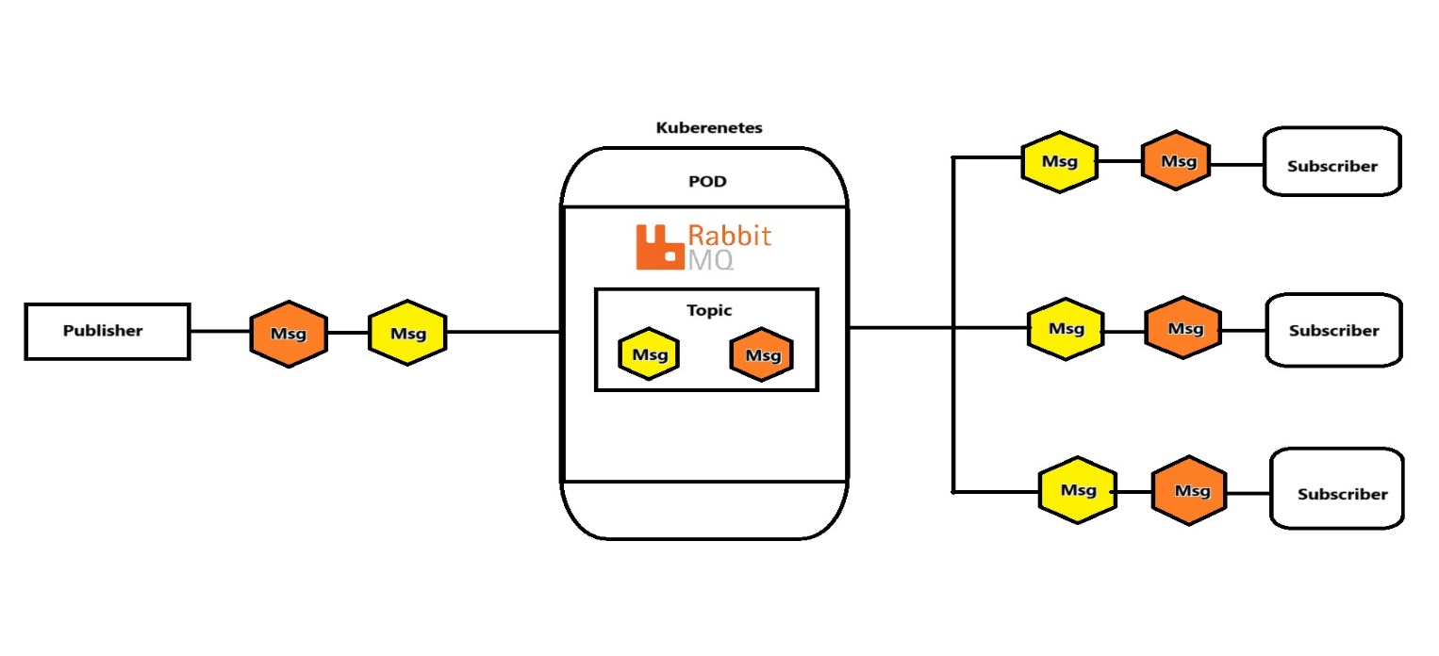
Architecture-Overview

Slide 9
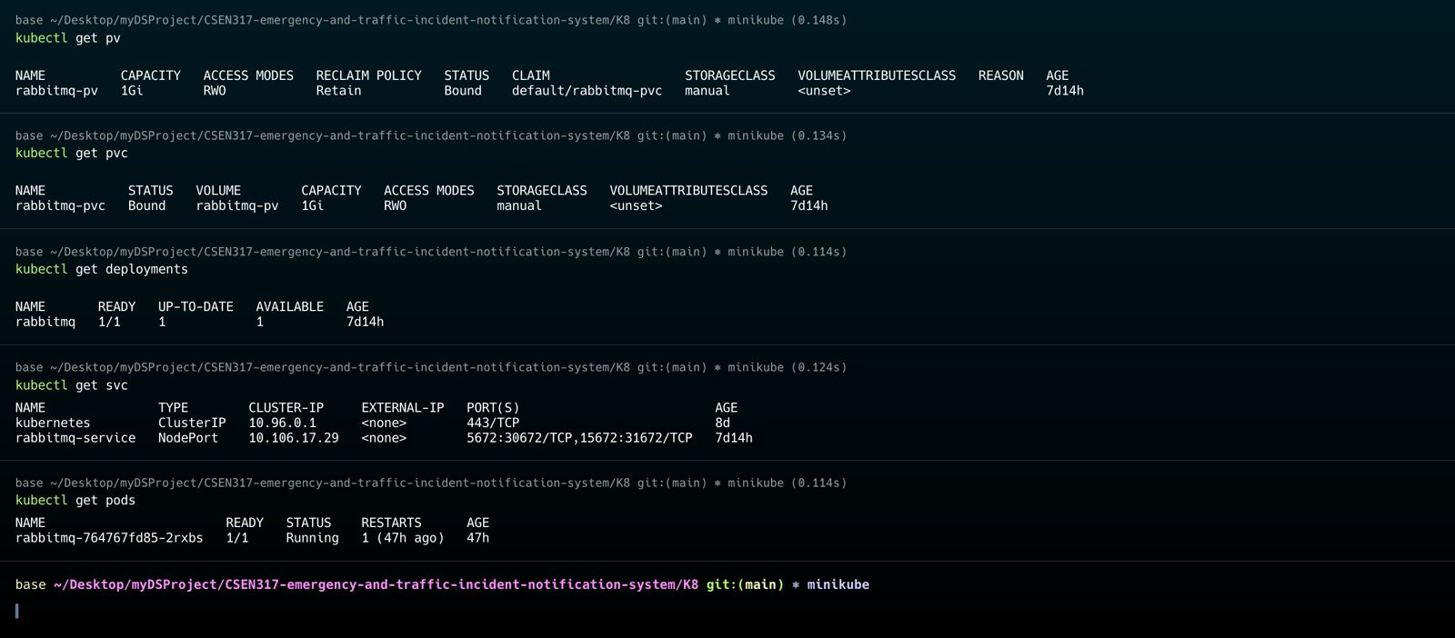
Kubernetes Objects

Slide 10
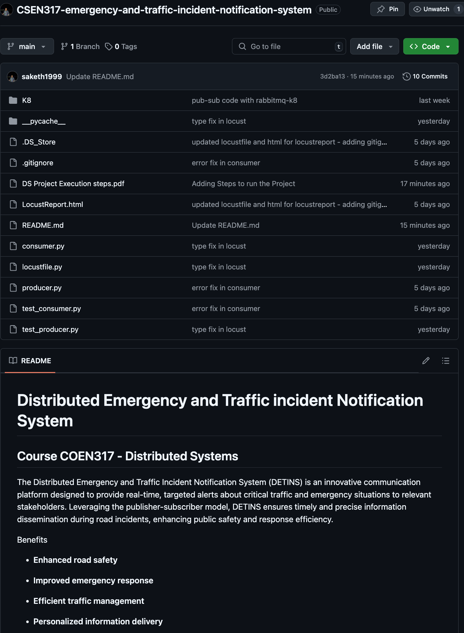
Repository Link
GITHUB: https://github.com/saketh1999/CSEN317-emergency-and-traffic-incident-notification-system
Please follow the steps in -
DS Project Execution pdf to run the project

Slide 11


Slide 12
Evaluation
Decoupled Microservices Architecture : The design allows services to communicate asynchronously, reducing their dependence on each other. This will improve the system's maintainability and scalability.
Scalability: RabbitMQ's capacity to handle high-volume and high-throughput messages is essential for real-time processing systems. Different queues and topics are used to assist scaling.
Load Testing with Locust: The system is mostly stable, even though the one failure of the publish request suggests room for improvement.
Reliability and Performance: To assist consumers share the burden equally, customer service uses Prefetch_count=1.

Slide 13
Metrics for Evaluation
Throughput: The system appears to be able to manage a considerable load as measured in Requests Per Second (RPS), with a maximum RPS of 40 for aggregated requests.
Latency: The system has variable latencies for different operations, according to the response time statistics. The subscribe and unsubscribe functions, for example, have longer maximum response times, which may suggest that they require more resources.
Error Rate: The load test shows a low error rate, with only one publish operation failing, suggesting that the system is reasonably reliable under the given conditions.

Slide 14
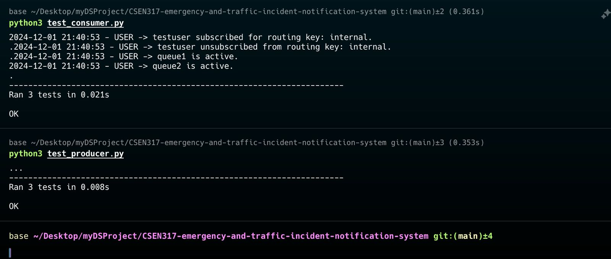
Unit Testing

Slide 15
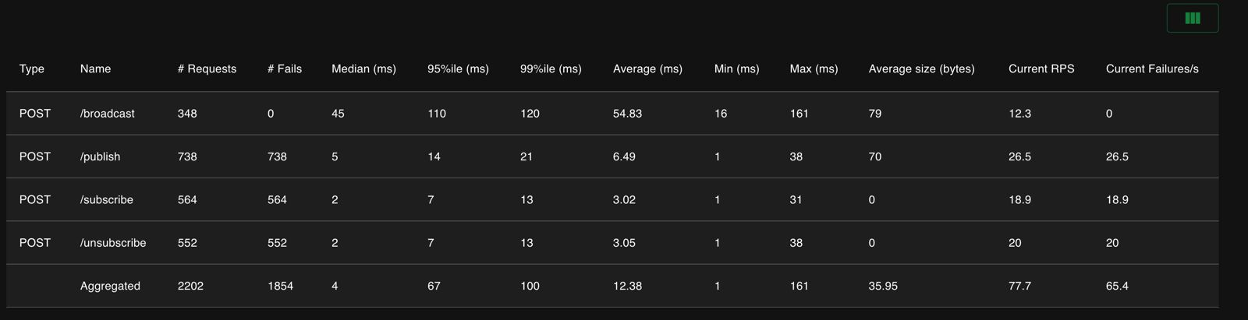
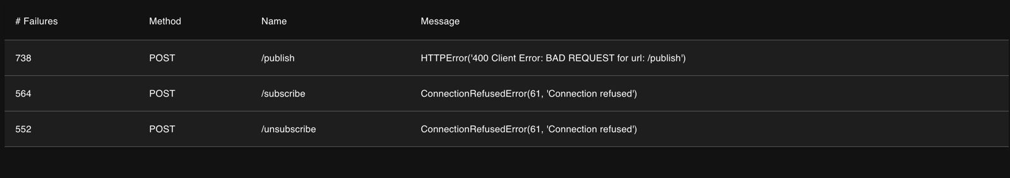
Load Testing using Locust

Slide 16
Future Plans
Optimization and Tuning:
The system may require optimization in light of the latency and the one failure that was noticed. This could entail fine-tuning Kubernetes resource allocation, optimizing Flask application code, or adjusting RabbitMQ setups.
Scalability Testing:
The system's scalability will be tested by gradually raising the load until it reaches the system's maximum capacity, in addition to the present load tests. This will assist in determining when the system must scale out.
High Availability and Fault Tolerance:
Priorities could include putting high-availability setups for RabbitMQ into place and making sure the Kubernetes deployment can withstand node failures without causing service interruptions.
Monitoring and Alerting:
Establishing thorough monitoring and alerting for RabbitMQ and the Flask application within Kubernetes to obtain up-to-date information on the system's health and performance.

Slide 17
Summary
Microservices Architecture
Message Brokering with RabbitMQ
Consumer Service
Producer Service
Load Testing with Locust
Logging and Monitoring
Error Handling and Reliability
Deployment in Kubernetes
Python and Flask

